Slide 1

A Dynamic Data-Driven Architecture for Mobile Application Shells
Modular Mobile Application Shell with Dynamic Content Adaptation
Presented by Berat Ferit OZGUL

Slide 2
OVERVIEW
Table of Contents
01
02
03
Introduction
Literature Review
System Design & Architecture
Background, Problem, Objectives, and Scope
Mobile App Architectures & Data-Driven Design
Conceptual Model, Data Flow & Modular Structure
04
05
Implementation & Testing
Conclusions & Future Work
Technologies Used and Validation
Summary

Slide 3

CHAPTER 1
Introduction: Background and Problem Statement
Mobile applications today serve an incredibly diverse range of purposes, from social networking to e-commerce and education. However, traditional development often necessitates separate codebases for each application type, even when they share fundamental functionalities.
This siloed approach leads to significant challenges:
Extensive code duplication across projects
Increased maintenance overhead and complexity
Higher development costs and slower time-to-market
This thesis addresses these issues by proposing a novel solution: a single, flexible application shell capable of dynamically adapting its structure and functionality based on external configuration. This paradigm shift eliminates the need for redundant codebases, streamlining development and enhancing scalability.

Slide 4

CHAPTER 1
Introduction: Objectives and Project Scope
Main Objective
To design and implement a modular mobile application shell that dynamically adapts its user interface and logic based on external configuration files. This innovation enables the rapid creation of customizable applications without requiring a rebuild of the core codebase for each new application type.
Project Scope
The system supports three distinct application types:
A dynamic news feed platform
A configurable e-commerce storefront
A personalized learning management system
It incorporates advanced personalization features that learn from user behavior to tailor content. The project leverages Flutter for cross-platform compatibility (Android and iOS) and adheres to a development cycle, structured into six agile phases.

Slide 5

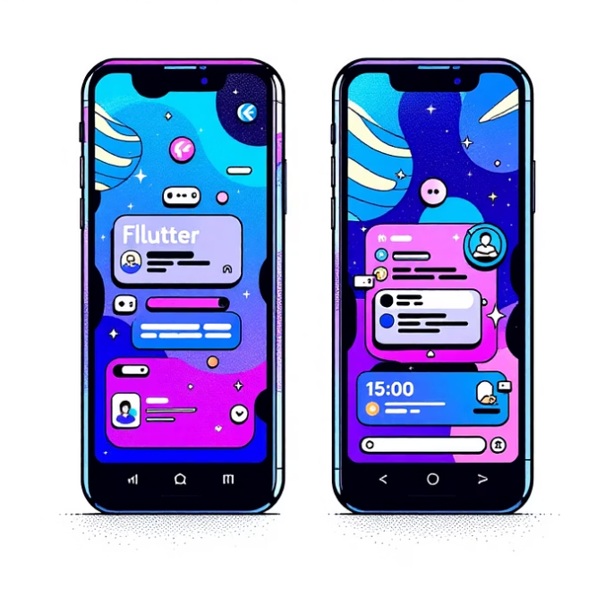

CHAPTER 2
Literature Review: Mobile App Architectures
Traditional Development
Cross-Platform Frameworks
Configuration-Driven Approach
Demands separate codebases for each distinct application, leading to significant code duplication, increased development time, and higher maintenance costs. This creates inefficiency and slows innovation.
Tools like Flutter enable a single codebase for multiple platforms (iOS, Android). While efficient for platform portability, they still typically require separate projects for different functional application types.
Common in web development, this method separates application structure and behavior through external configuration files (e.g., JSON). Its adoption in mobile development has been limited, representing a crucial opportunity for advancement.
Our proposed architecture aims to bridge this gap, bringing the power and flexibility of configuration-driven design to mobile applications.

Slide 6
CHAPTER 2
Literature Review: Data-Driven Design and Related Technologies
Data-Driven Design Principles
Key Technologies
At its core, data-driven design leverages external configuration files (e.g., JSON, XML, YAML) to decouple an application's structure from its content and behavior. This allows for:
Flutter: A UI toolkit for building natively compiled applications for mobile, web, and desktop from a single codebase.
Dart: Optimized for UI, enabling fast development and high performance, with strong type safety.
Riverpod: A robust state management library offering compile-time safety and dependency injection.
HTTP Package: For making efficient network requests to fetch remote data.
SharedPreferences: Provides simple persistent storage for local data and caching.
JSON: The chosen lightweight and human-readable format for configuration files.
Dynamic UI Generation: Widgets are constructed at runtime based on the configuration.
Runtime Adaptability: The same codebase can render vastly different interfaces.
Increased Flexibility: Rapid changes without code modifications or redeployments.

Slide 7

CHAPTER 3
System Design: Conceptual Model
The core of the system is an adaptive application shell that modifies its behavior and appearance based on external configuration. This shell encompasses several critical components:
Configuration Loader: Fetches and parses configuration files.
Module Registry: Manages mappings between module types and their corresponding UI builders.
Data Source Abstraction: Provides a unified interface for data retrieval.
User Tracking: Captures user interactions for analytics and personalization.
Personalization Algorithms: Tailors content presentation based on user profiles.
JSON Configuration Files
Dynamic Module System
Data Abstraction Layer
These files define the application's entire structure, including name, theme, navigation pathways, available modules, and data source endpoints. They are the blueprint for dynamic adaptation.
Through the module registry, the system dynamically generates UI components by mapping module types specified in the configuration to specific Flutter widget builders.
Ensures consistent access to diverse data sources, whether from remote REST APIs or local storage, presenting a unified interface to the application shell.

Slide 8
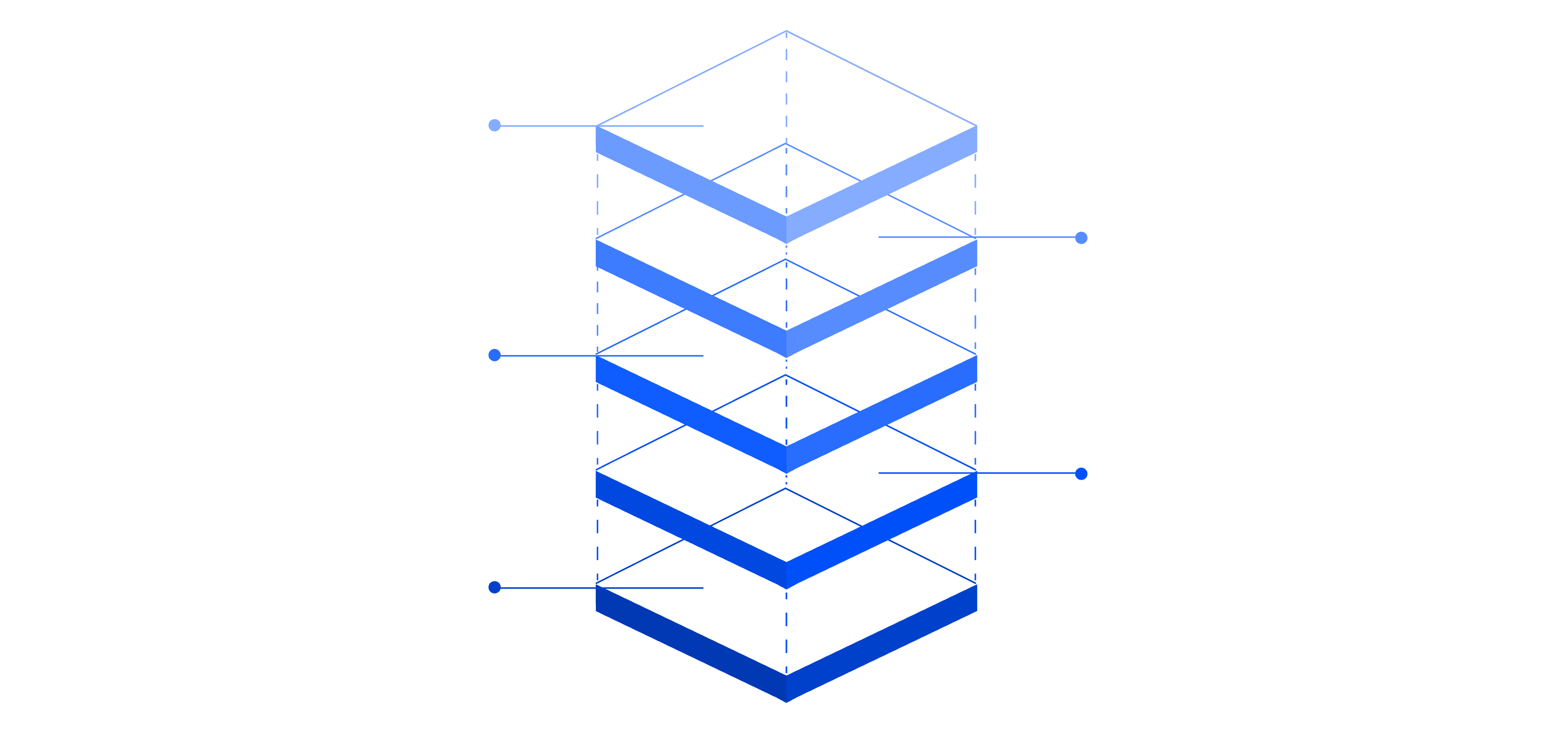
CHAPTER 3
System Design: Data Flow
Update Personalization
Adjust settings and preferences
Track Interactions
Collect user events and metrics
Render Content
Display UI with loaded resources
Init Modules
Register and initialize core modules
Load Configuration
Fetch remote config with cache fallback
The data flow initiates with the system loading configuration, prioritizing remote sources with a fallback to a cached version. This ensures resilience and up-to-date content delivery. Once loaded, the module registry is initialized, enabling the shell to dynamically display UI components as defined.
During screen rendering, individual modules asynchronously fetch content from their designated data sources. All user interactions are meticulously tracked, updating a centralized user profile. This profile then fuels the personalization system, which employs ranking algorithms to present content tailored to individual user behavior, creating a continuous feedback loop.

Slide 9
CHAPTER 3
System Design: Modular Shell Structure and Architecture
The architecture adopts a clean layered approach to ensure separation of concerns and maintainability:
Presentation Layer: Comprises Flutter widgets and screens, responsible for rendering the UI dynamically based on the module system.
Business Logic Layer: Houses core services like ConfigService (configuration management), TrackingService (user interaction logging), and Riverpod providers (state management).
Data Layer: Defines the DataSource interface, with concrete implementations such as ApiDataSource for remote fetching and LocalDataSource for cached or bundled data.
The module registry is central to flexibility, mapping module types to specific widget builders. User interactions are routed through the tracking service to update comprehensive user profiles, which the personalization system then leverages to apply sophisticated ranking algorithms, continually refining the content experience.

Slide 10

CHAPTER 4
Implementation: Technologies Used
Flutter
Dart
Cross-platform UI toolkit for building natively compiled applications from a single codebase. Accelerates development with hot reload and declarative UI.
Optimized for UI development, offering high performance and developer productivity, with strong type safety and null safety features.
Riverpod
HTTP Package
State management and dependency injection framework providing compile-time safety and robust, testable architecture.
Facilitates efficient and reliable network requests for fetching data from remote APIs.
SharedPreferences
JSON
Lightweight key-value storage for local data persistence and caching mechanisms.
The chosen data interchange format for external configuration files due to its readability and widespread adoption.
This combination of technologies ensures a robust, scalable, and maintainable system. Flutter's widget-based architecture and hot reload significantly enhance development speed, while Riverpod's principles promote clean architecture and modularity.

Slide 11
Implementation: App Development Process
The development of our configuration-driven mobile application was structured across six distinct phases. This methodical approach ensured robust foundational design and systematic feature integration.
Phase 1: Foundation
1
Setup & Architecture Design
2
Phase 2: Core Implementation
Configuration Service, Data Sources, Module Registry
Phase 3: UI & Features
3
Module Widgets, Navigation, Theming, Tracking
4
Phase 4: Personalization
Ranking Algorithms & Content Filtering
Phase 5: App Configurations
5
Specific setups for three distinct app types
6
Phase 6: Testing & Docs
Comprehensive Testing & Documentation

Slide 12
Implementation: User Interfaces and Features
Our application delivers a suite of dynamic user interfaces, each constructed from configuration to ensure adaptability and a consistent user experience across diverse app types.
Configuration-Driven Design
All interfaces derive their aesthetic and structural elements—colors, fonts, and layouts—directly from the application's configuration. This approach enables the same underlying code to render visually distinct interfaces tailored to specific app types, showcasing the system's inherent flexibility and reusability.
Dynamic Screens
Home Screen: Scrollable list of modules.
Detail Screen: Adapts layout based on item type.
Categories Screen: Grid layout for efficient filtering.
Search Screen: Incorporates tracked queries for personalized results.

Slide 13
Testing: Approach and Validation
Our rigorous testing strategy encompassed multiple levels to ensure the stability, functionality, and performance of the application. Comprehensive testing validated the effectiveness of our configuration-driven architecture.
Testing Phases
Key Results
Unit Tests: Focused on granular components such as configuration parsing, data source integrity, user profiles, and the ranking algorithm.
Integration Tests: Validated end-to-end application flows, ensuring seamless interaction between different modules and services.
Manual Testing: Explored diverse configurations, offline behavior, and specific error cases to guarantee robustness.
All core functionalities were confirmed to operate correctly. Configuration loading from both local and remote sources, including proper caching, performed as expected. Modules rendered accurately, data sources fetched data successfully, and personalization mechanisms functioned effectively.

Slide 14
Conclusions: Summary of Results
This project conclusively demonstrates the power of a configuration-driven design, proving that a single codebase can adeptly serve diverse application purposes. The Flutter shell dynamically transforms into distinct app types—such as news, e-commerce, and learning platforms—simply by loading different JSON configurations, completely circumventing the need for code modifications.
Robust Configuration
Dynamic UI Building
Easy Module Addition
System with efficient caching for rapid deployment.
User interfaces constructed directly from configuration inputs.
Streamlined process through a centralized registry.
Unified Data Sources
Effective Personalization
Seamless integration and flexible switching.
Tailored user experiences through intelligent algorithms.
The successful implementation of three complete app configurations further solidifies the architecture's flexibility, and comprehensive testing has verified that all specified requirements are met.

Slide 15
Conclusions: Achievements and Limitations
While the project achieved significant milestones in promoting efficiency and adaptability, it also highlighted areas for future refinement.
Achievements
Limitations
Single Codebase: Eliminates duplication and reduces development time.
Rapid App Type Creation: Accelerates new app deployment via configuration.
Simplified Maintenance: Centralized management of core features.
Enhanced UX: Personalization improves user experience.
Extensible Architecture: Facilitates easy addition of new features.
Proprietary Configuration: Format is implementation-specific.
Code Dependency: Complex features may still require direct code changes.
Basic Personalization: Current algorithm is foundational; lacks advanced ML.
Platform Focus: Primary testing conducted on Android devices.

Slide 16
Future Work: Development Directions
To evolve this project into a more comprehensive and powerful platform, several key development directions are envisioned, focusing on enhanced user experience, expanded functionality, and improved developer tooling.
Enhanced Personalization
Additional Modules
Integrate collaborative filtering, advanced ML models, and cloud-based recommendation services for richer, more accurate content delivery.
Develop new dynamic modules, including video players, interactive quizzes, social feeds, and sophisticated chat interfaces.
Configuration Validation
Performance Optimizations
Implement JSON schema validation for configurations to enable early detection of errors and ensure data integrity.
Introduce pagination, lazy loading, API caching, and image optimization techniques to significantly improve application responsiveness.

Slide 17





Key Takeaways
The project highlights several crucial insights into modern mobile application development, emphasizing the benefits of a strategic architectural approach.
Configuration-Driven Efficiency
Significantly reduces development time and maintenance by enabling multiple app types from a single codebase.
Dynamic UI Customization
Allows rapid interface adaptation without code modifications, fostering unparalleled flexibility.
Enhanced User Experience
Personalization features improve engagement, while modularity ensures robust extensibility for future growth.
Modern Frameworks & Architecture
Leveraging Flutter, Dart, and Riverpod creates flexible, reusable, and maintainable platforms ready for real-world applications.
This project validates the configuration-driven mobile app shell as a practical and effective solution for diverse application needs.

Slide 18



Questions & Discussion
Thank you for your valuable attention and engagement throughout this presentation.
Your insights are welcome.
We look forward to an open discussion.

